Slide 1
SC1007
Tutorial 5: Hash Table

Slide 2
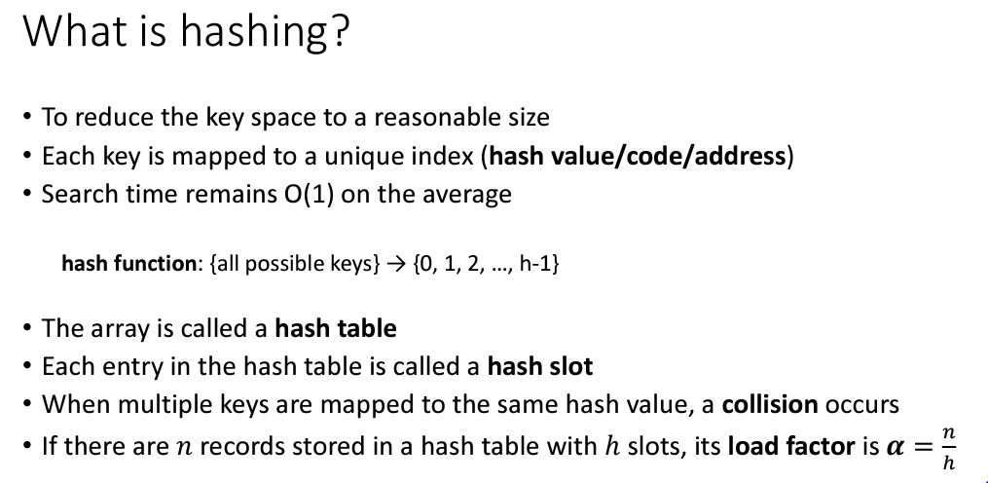
Hash table (review)

Slide 3
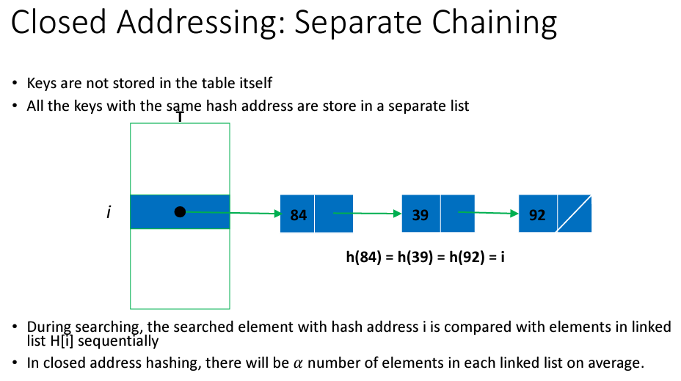

Slide 4
Open Addressing
Keys are stored in the table itself
When collision occurs, probe is required for the alternate slot
  Linear Probing
    H(k,i) = (H(k)+i) mod h, i = 0, 1, 2,…, h-1
  Quadratic Probing
    H(k,i) = (H(k)+c₁i+c₂i²) mod h, i = 0, 1, 2,…, h-1
  Double Hashing
    H(k,i) = (H(k)+iD(k)) mod h, i = 0, 1, 2,…, h-1

Slide 5
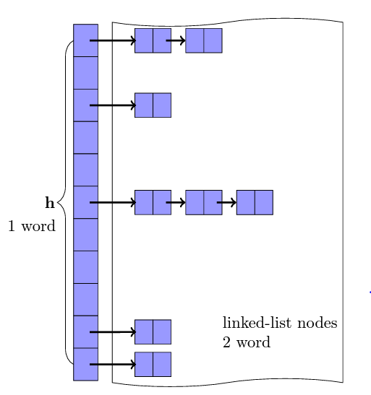
Q1
The type of a hash table H under closed addressing is an array of list references, and under open addressing is an array of keys. Assume a key requires one “word” of memory and a linked list node requires two words, one for the key and one for a list reference.
Consider each of these load factors for closed addressing: 0.5, 1.0, 2.0. Estimate the total space requirement, including space for lists, under closed addressing
Assuming that the same amount of space is used for an open addressing hash table, what are the corresponding load factors under open addressing?

Slide 6

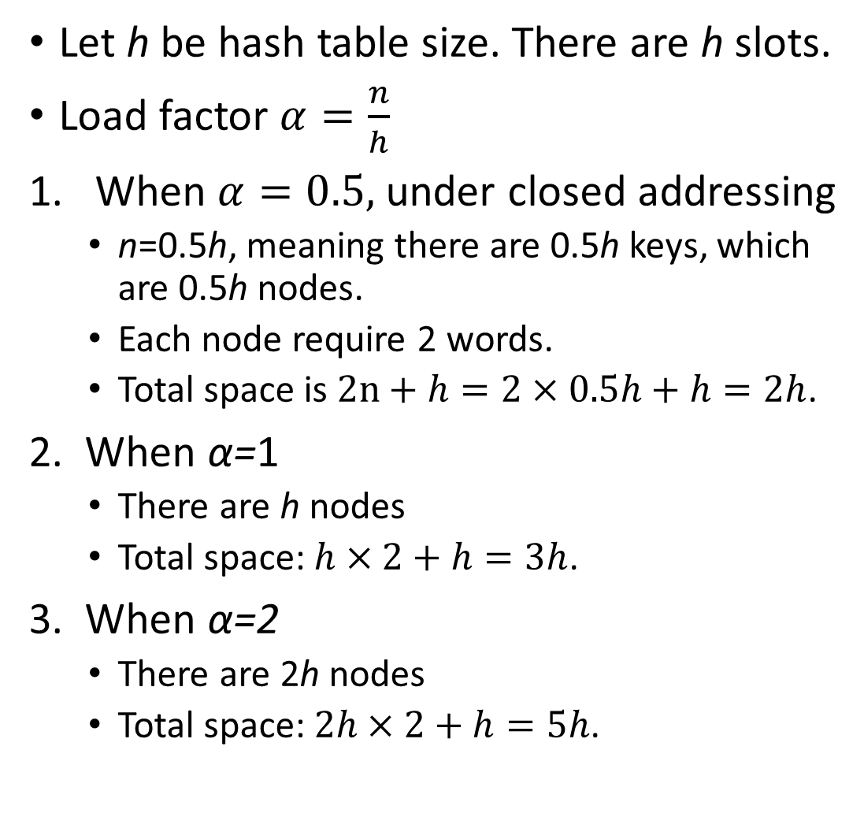
2 words
Let h be hash table size. There are h slots.
Load factor $α=\frac{n}{h}$
When $α=0.5,$under closed addressing
  n=0.5h, meaning there are 0.5h keys, which are 0.5h nodes.
  Each node require 2 words.
  Total space is $2n+h=2×0.5h+h=2h$.
2. When α=1
  There are h nodes
  Total space: $h×2+h=3h$.
3. When α=2
  There are 2h nodes
  Total space: $2h×2+h=5h$.
10 slots, requiring 10 words
$α=0.5$

Slide 7
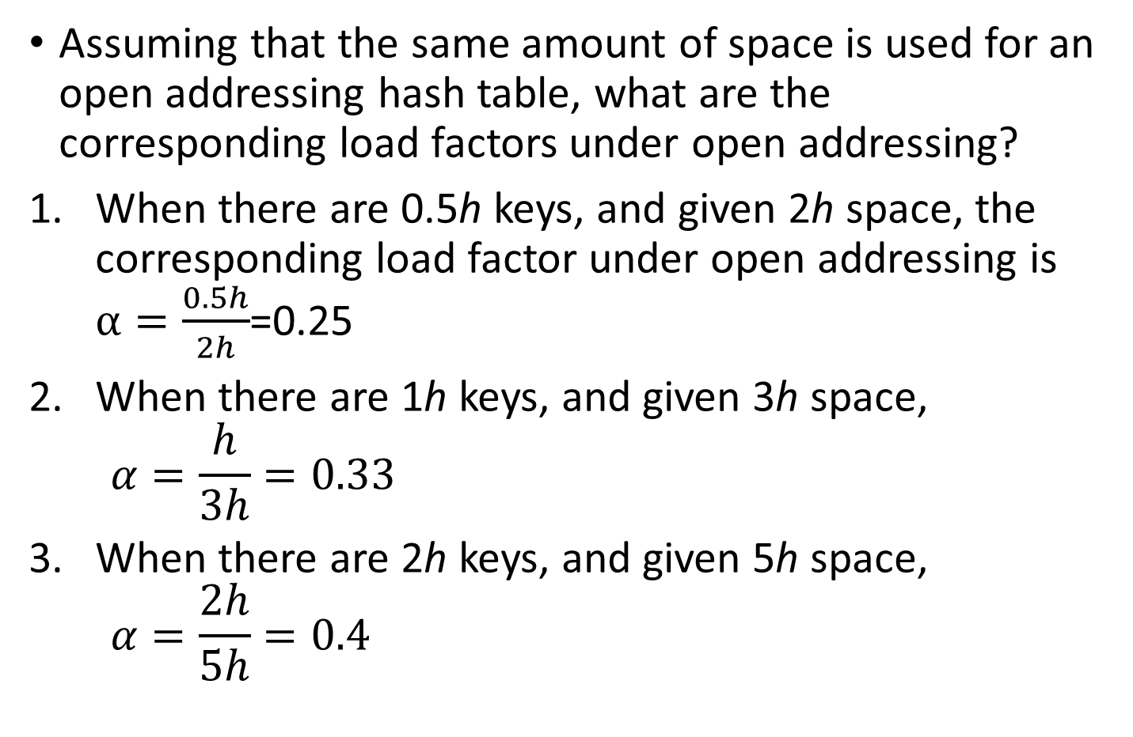
Assuming that the same amount of space is used for an open addressing hash table, what are the corresponding load factors under open addressing?
When there are 0.5h keys, and given 2h space, the corresponding load factor under open addressing is $α=\frac{0.5h}{2h}$=0.25
When there are 1h keys, and given 3h space,
$$α=\frac{h}{3h}=0.33$$
When there are 2h keys, and given 5h space,
$$α=\frac{2h}{5h}=0.4$$
20 slots
20 words

Slide 8
Q2
Consider a hash table of size n using open address hashing and linear probing. Suppose that the hash table has a load factor of 0.5, describe with a diagram of the hash table, the best-case and the worst-case scenarios for the key distribution in the table.
For each of the two scenarios, compute the average-case time complexity in terms of the number of key comparisons when inserting a new key. You may assume equal probability for the new key to be hashed into each of the n slots. [Note: Checking if a slot is empty is not a key comparison.]

Slide 9
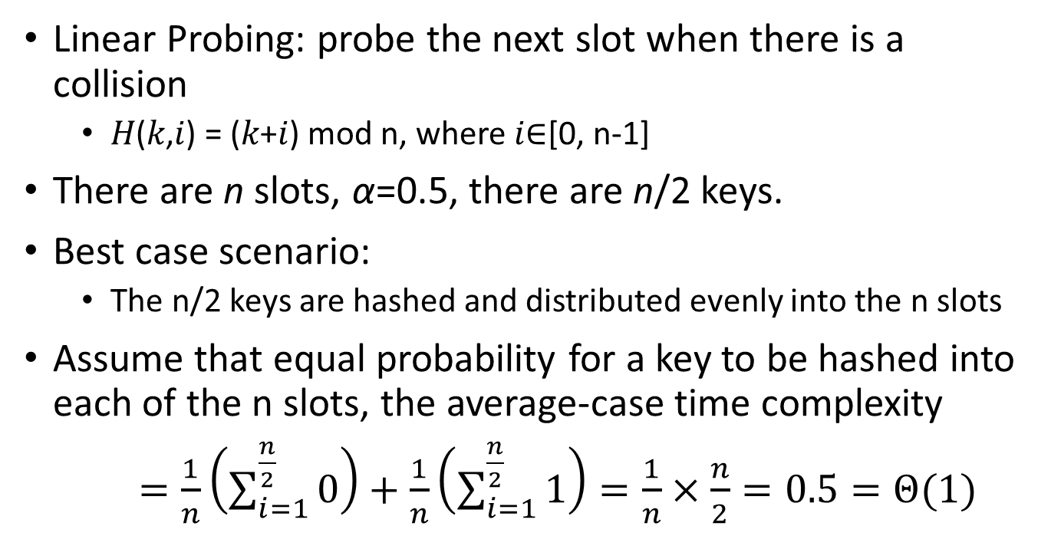
n=7
𝐻(𝑘) = k mod n
Linear Probing: probe the next slot when there is a collision
  𝐻(𝑘,𝑖) = (𝑘+𝑖) mod n, where 𝑖∈[0, n-1]
There are n slots, α=0.5, there are n/2 keys.
Best case scenario:
  The n/2 keys are hashed and distributed evenly into the n slots
Assume that equal probability for a key to be hashed into each of the n slots, the average-case time complexity
$=\frac{1}{n}\left(\sum_{i=1}^{\frac{n}{2}}{0}\right)+\frac{1}{n}\left(\sum_{i=1}^{\frac{n}{2}}{1}\right)=\frac{1}{n}×\frac{n}{2}=0.5=Θ(1)$
0
0
1
2
2
3
4
4
5
6
6

Slide 10
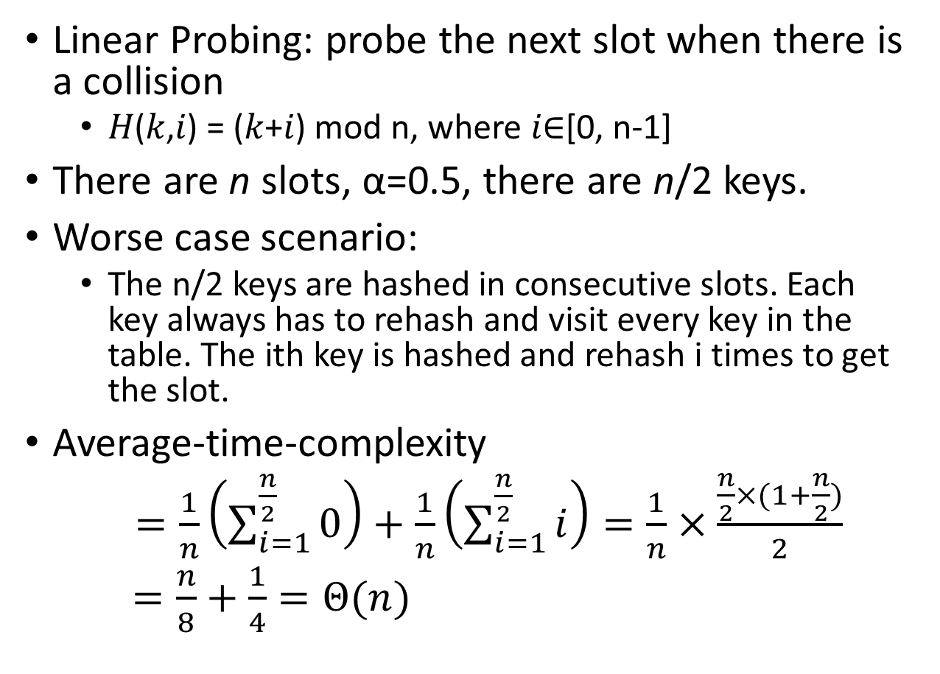
n=7
𝐻(𝑘) = k mod n
Linear Probing: probe the next slot when there is a collision
  𝐻(𝑘,𝑖) = (𝑘+𝑖) mod n, where 𝑖∈[0, n-1]
There are n slots, α=0.5, there are n/2 keys.
Worse case scenario:
  The n/2 keys are hashed in consecutive slots. Each key always has to rehash and visit every key in the table. The ith key is hashed and rehash i times to get the slot.
Average-time-complexity
$=\frac{1}{n}\left(\sum_{i=1}^{\frac{n}{2}}{0}\right)+\frac{1}{n}\left(\sum_{i=1}^{\frac{n}{2}}{i}\right)=\frac{1}{n}×\frac{\frac{n}{2}×(1+\frac{n}{2})}{2}$
$=\frac{n}{8}+\frac{1}{4}=Θ(n)$
0
1
2
3
3
10
4
17
5
24
6

Slide 11
Q3
Consider a hash function: h(𝑘)=𝑘 𝑚𝑜𝑑 𝑚, where 𝑚=2^{𝑝}−1 and 𝑘 is a character string interpreted in radix 2^{𝑝}. Show that if string 𝑥 and be derived from string 𝑦 by permuting its characters, then 𝑥 and 𝑦 hash to the same value.

Slide 12
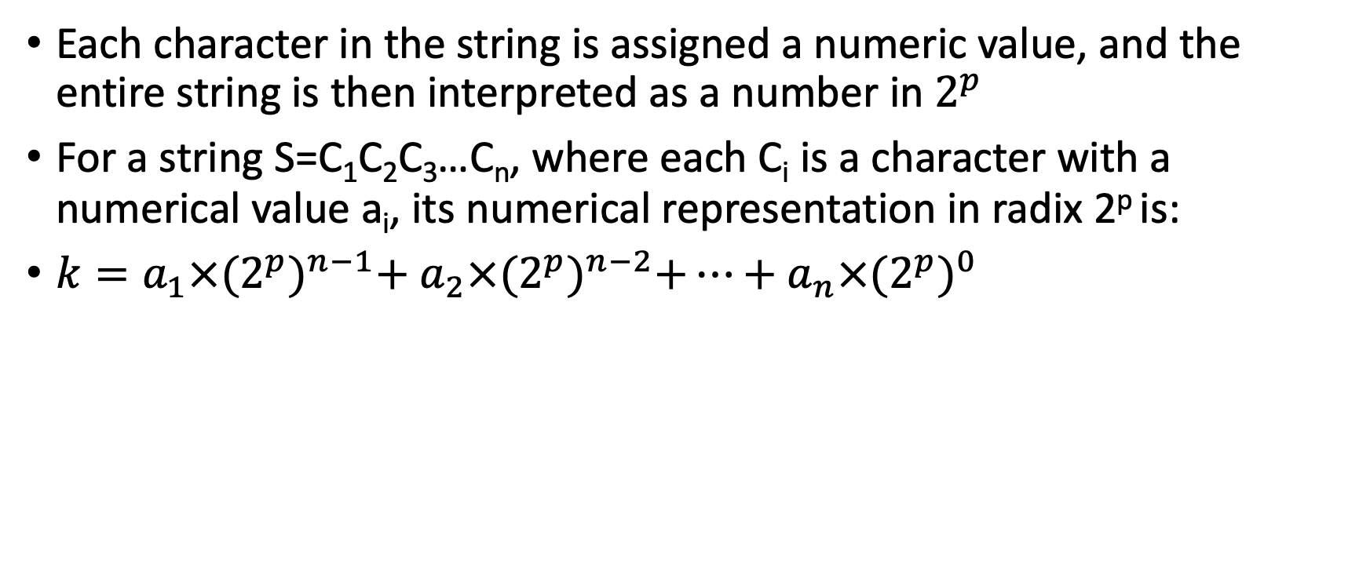
Q3
Each character in the string is assigned a numeric value, and the entire string is then interpreted as a number in $2^{p}$
For a string S=C₁C₂C₃…C_{n}, where each C_{i}​ is a character with a numerical value a_{i}, its numerical representation in radix 2^{p} is:
$k=a_{1}×{(2^{p})}^{n−1}+$ $a_{2}×{(2^{p})}^{n−2}+…+$ $a_{n}×{(2^{p})}^{0}$

Slide 13
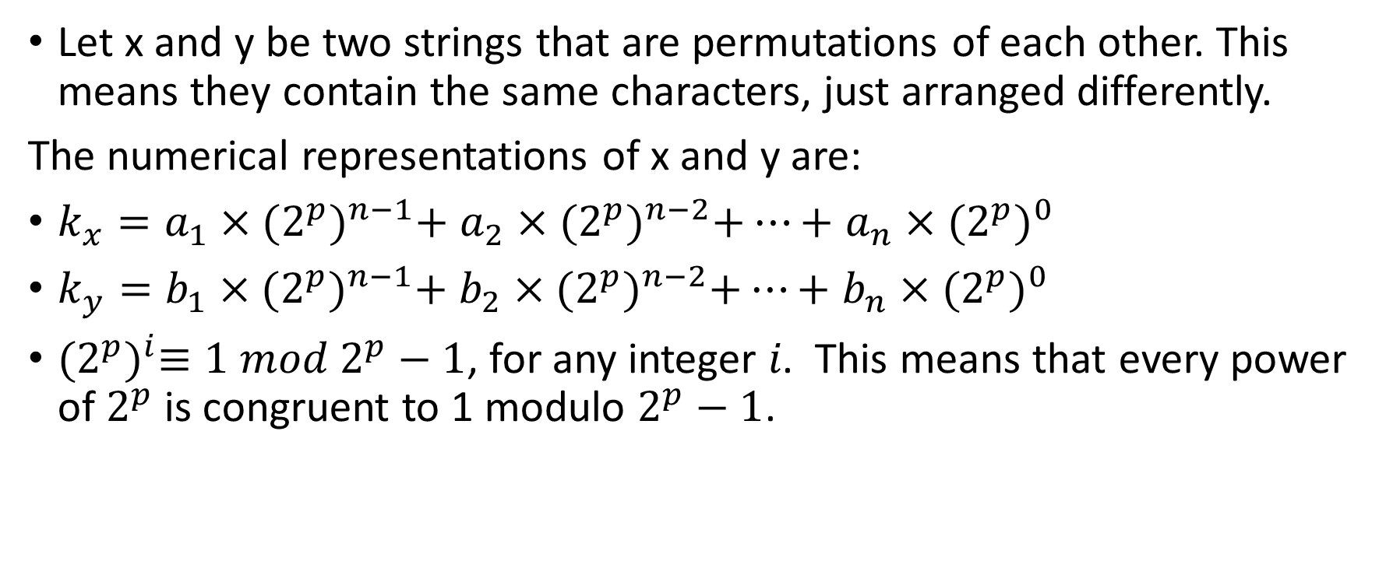
Q3
Let x and y be two strings that are permutations of each other. This means they contain the same characters, just arranged differently.
The numerical representations of x and y are:
$k_{x}=a_{1}×{(2^{p})}^{n−1}+$ $a_{2}×{(2^{p})}^{n−2}+…+$ $a_{n}×{(2^{p})}^{0}$
$k_{y}=b_{1}×{(2^{p})}^{n−1}+$ $b_{2}×{(2^{p})}^{n−2}+…+$ $b_{n}×{(2^{p})}^{0}$
${(2^{p})}^{i}≡1 mod 2^{p}−1$, for any integer 𝑖. This means that every power of $2^{p}$is congruent to 1 modulo $2^{p}−1$.

Slide 14
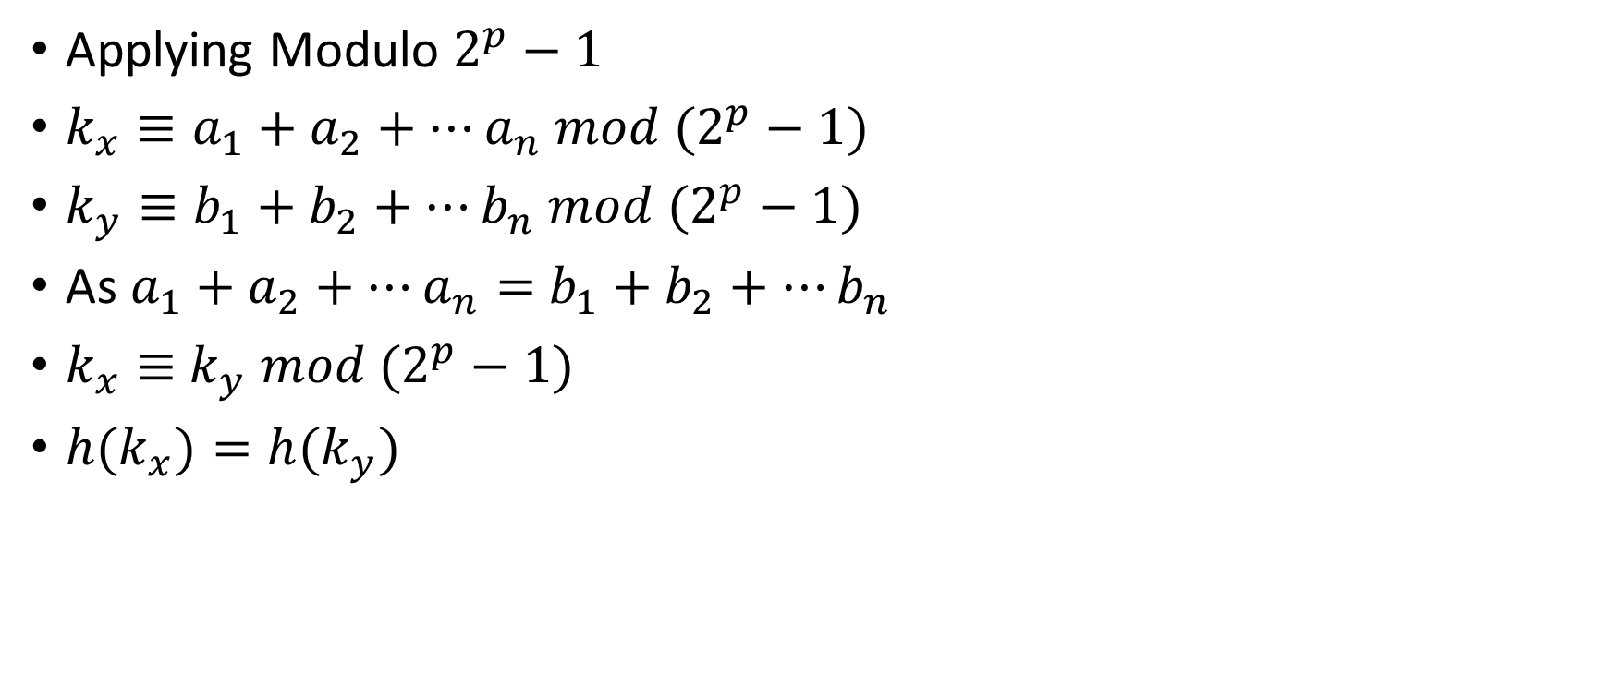
Q3
Applying Modulo $2^{p}−1$
$k_{x}≡a_{1}+a_{2}+…a_{n} mod (2^{p}−1)$
$k_{y}≡b_{1}+b_{2}+…b_{n} mod (2^{p}−1)$
As $a_{1}+a_{2}+…a_{n}=$ $b_{1}+b_{2}+…b_{n}$
$k_{x}≡$ $k_{y}$ $mod (2^{p}−1)$
${h(k}_{x})=h(k_{y})$

Slide 15
Q3
This property can lead to hash collisions in applications where order matters.
Password Hashing"1234" and "4321" should produce different hashes, but under this scheme, they do not.
Database Indexing "ABCD" and "BCDA" mapping to the same hash could cause incorrect lookups.
Cryptographic Signatures: Digital signatures should change if even a small character swap happens.

